Slide 1
Use the right Email Services
I Recommend AWeber, Get Response or InfusionSoft

Slide 2
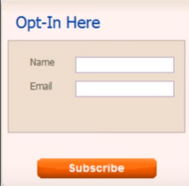
Make easy to subscribe. the more subscribers we get. We don’t make people work to get our emails.

Slide 3
Define Our Audience
If we are getting subscribers without making sure that they are interested in our niche, we wont have much success. Our numbers will be terrible.

Slide 4
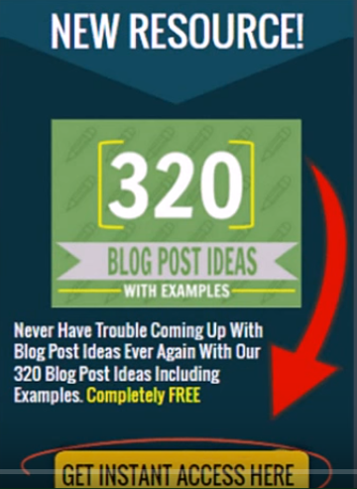
Create a free Lead Magnet if don’t have much Leads.
Gone are the days when people just sign up for a newsletter. Offer a lead magnet that is related to our niche and we will offers lots of value for free.

Slide 5
Always Have A Welcome Email. We don’t Email them just to sell the product we have to Build Relationship and Trust.
People expect email after subscribing. This will be our most opened Email in our autoreponder. Make people feel like they make a good dicision to subscribe and make sure we will give them what they want right away.

Slide 6
Send Yourself A Test Email
Make sure the email Services are running smoothly and the email looks good before we ever send our first email or make autoresponder active.

Slide 7
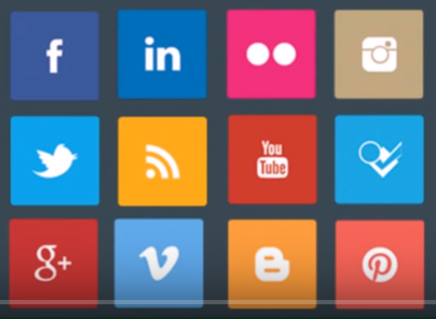
Encourage Subscribers to Follow our own Social Media
One of our first email and our autoresponder should encourage subscribers to connect with us on social media. The more ways they connect to us, the more likely they are to see our content or offers.

Slide 8
Make Sure People Are Able To Unsubscribe
It is actually illegal for people to get marketing emails without unsubscribe option.

Slide 9
Have Autoresponder Base on Subscriber’s Time.
If we have all local clients, we can just send emails base on most popular open times. If we have a business that covers an entire country or multiple countries, like an internet business, we will make sure autoresponder emails are based on the each user’s subscriber time. Or, we could even specified emails to go at a certain time while adapter to their given time zone

Slide 10
Make sure our emails Says “From (Our Brand)”
If the subscribers don’t know where the emails is from, We don’t do very well. It should be from your name or company’s name.

Slide 11
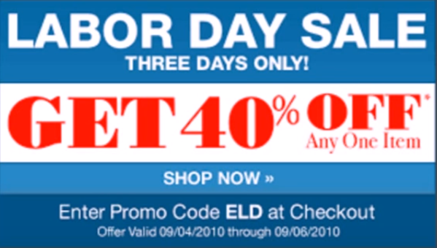
Use Scarcity
People will buy our offer much faster if we have a limited supply and they are forced to make a fairly quick decision

Slide 12
Pay Attention to Open And Click Rates
Subject Line = Open Rate (Good = 80% or more)
Email Body = Click – Through rate (Good = 5-7% or more)

Slide 13
Use the 80/20 rule
We don’t want our subscribers to think all we care about selling them staff. Send them value (like blogs, posts, videos, podcast, etc.) 80% of time and promotions 20%.

Slide 14
Use Short, Punchy Subject Lines
The longer the headlines, the smaller the open rate could be and the more likely it is that our subscribers can’t even read the whole thing.
I usually use the these headline examples:
Open up:-)
IMPORTANT (new case study)
TIME SENSITIVE (great news)
Hi [name]
Hey
[video] You asked for it.

Slide 15
Have Email Links Spread Throughout Email
When using links to offers or content through emails, we should have at least 2 links of the same thing that we want our subscribers to click (3 at the most). We should spread them through different parts of the email. This makes it easier for them to click, depending on which part of the email they are reading.

Slide 16
Always Have A Call To Action In Emails
If we don’t make things straightforward and simple, we won’t get as good of conversions. we will always tell our subscribers what we want them to do next in every email we send.

Slide 17
Segment Our Lists
Don’t assume that all our subscribers have the exact interests. Segment different lists based on different squeeze pages. Blog, posts they were reading, emails they open etc, to offer more targeted that they will be more likely to buy.

Slide 18
Use RSS Emails To Save Time For Blog Newsletter
If we publish multiple blog post a week with essentially the same email format every time we send an update to our list, we are wasting our productivity time. We will use RSS automated and craft our perfect template to make sure we send an email update out every time we publish a new post without having to rewrite emails every time.

